Slide 1
Taxi Management Software
With Complete Application Support

Slide 2
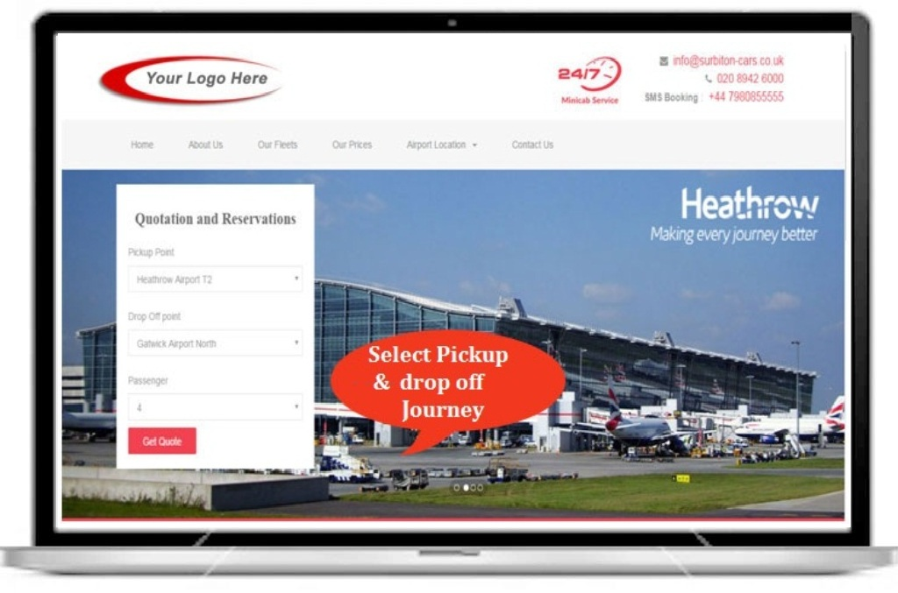
Select your Pickup and Drop-off Journey Details including number of Passenger details and Get a Quote.

Slide 3
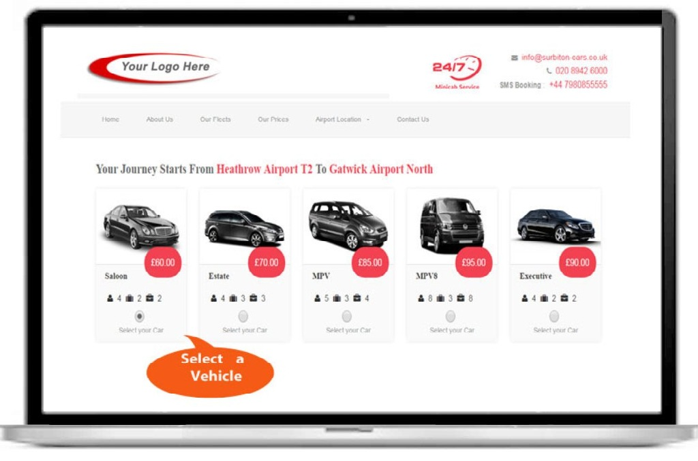
Select a Comfortable vehicle for your journey

Slide 4
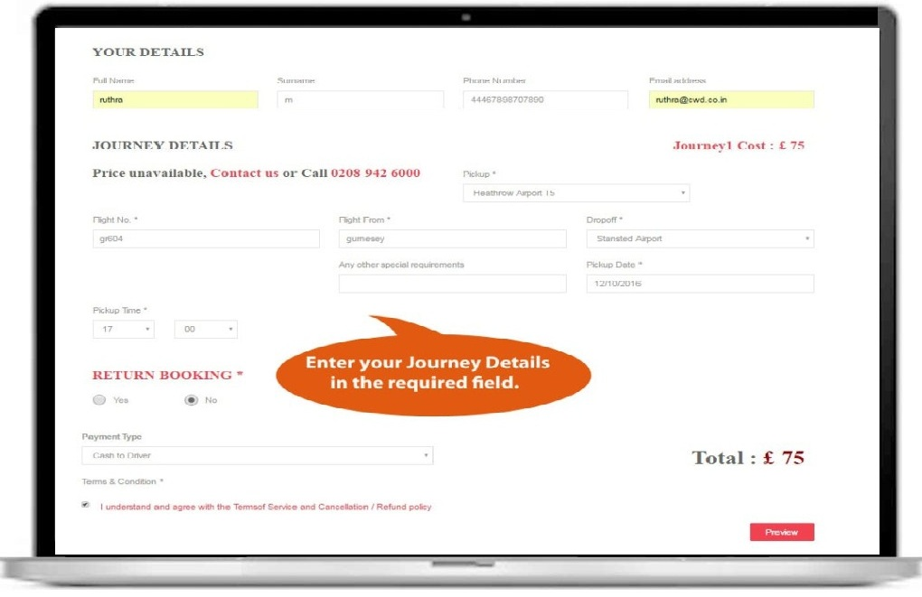
Once the vehicle has chosen, you need to enter the journey details which have shown below.
Here you have the option for RETURN journey and book the return trip details if required.

Slide 5
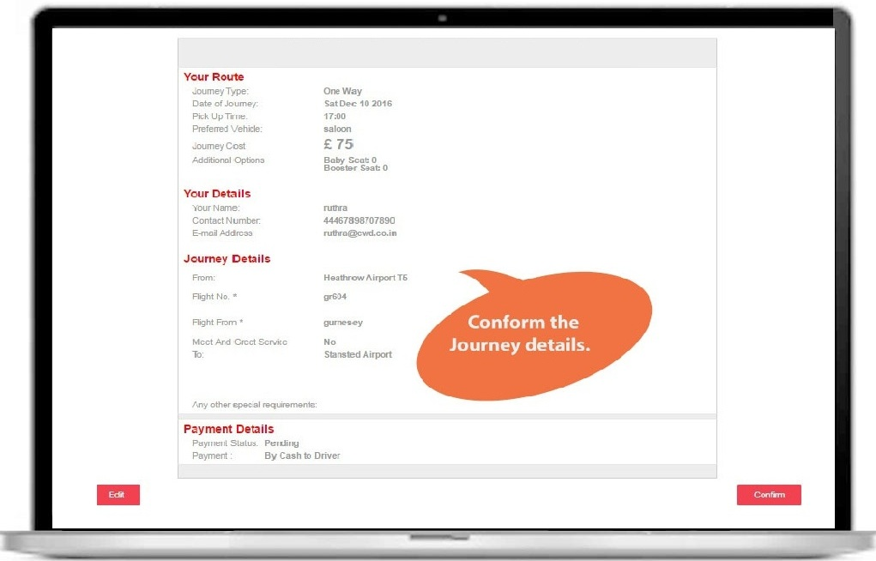
After the completion of journey details you need to accept the TERMS and CONDITIONS and enter the PREVIEW Option to conform your booking details.
Journey Details has shown below and click CONFIRM

Slide 6
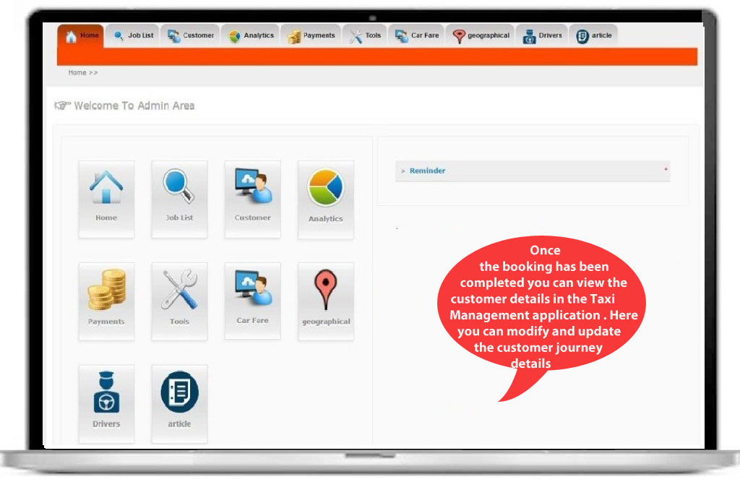
Admin:
The following image is an admin profile which shows all the details about the taxi management software which includes Job List, Customer Details, and analytics, Payment history, Tools, Car Fare, Geographical, Driver Details and Article (Front-end).

Slide 7
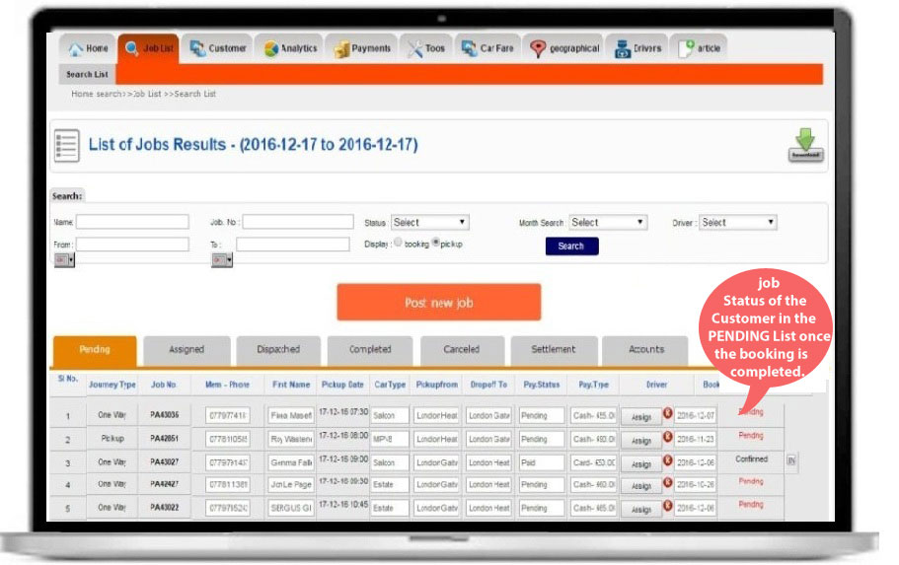
Customer Journey status will be in PENDING list once the booking has been completed.

Slide 8
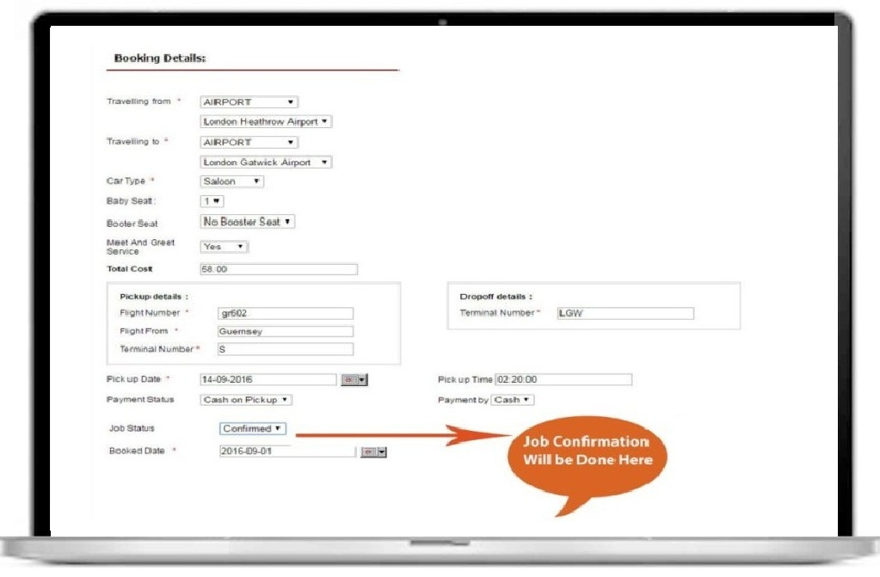
Customer Journey status will be updated here

Slide 9
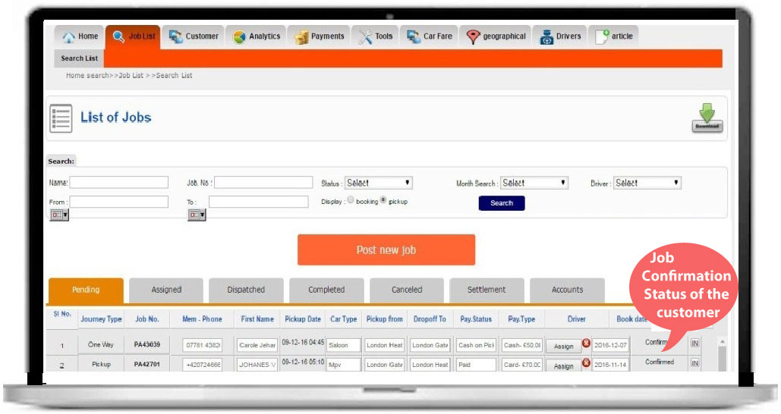
Once the customer job is CONFIRMED , you can enable the option IN to generate the INVOICE

Slide 10
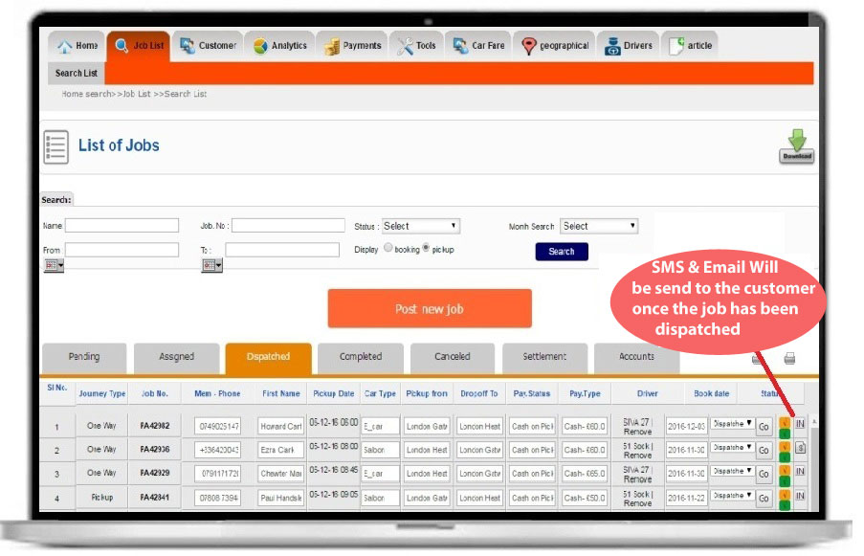
Dispatched Image has shown below which has two option i.e. Email and SMS option which is used to send the journey Details through SMS and EMAIL to the Customer and Driver

Slide 11
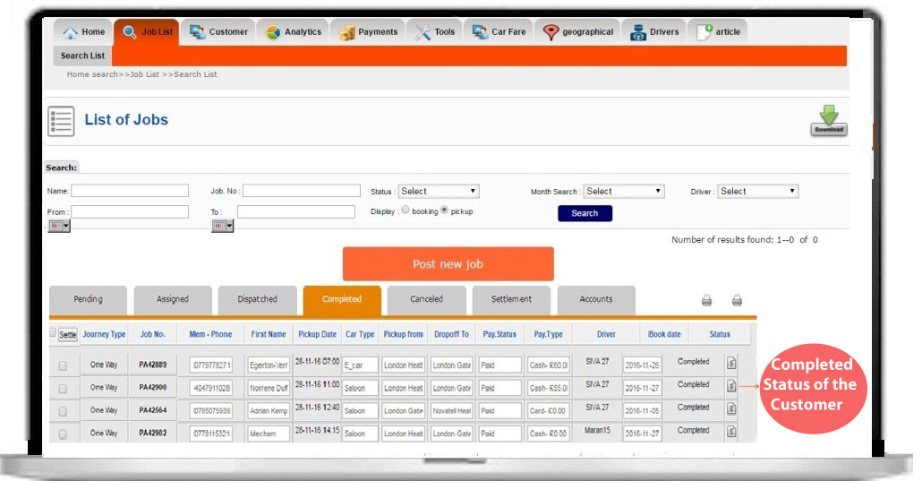
After the Completion of Journey, the journey status will be updated in the COMPLETE List which has shown below.

Slide 12
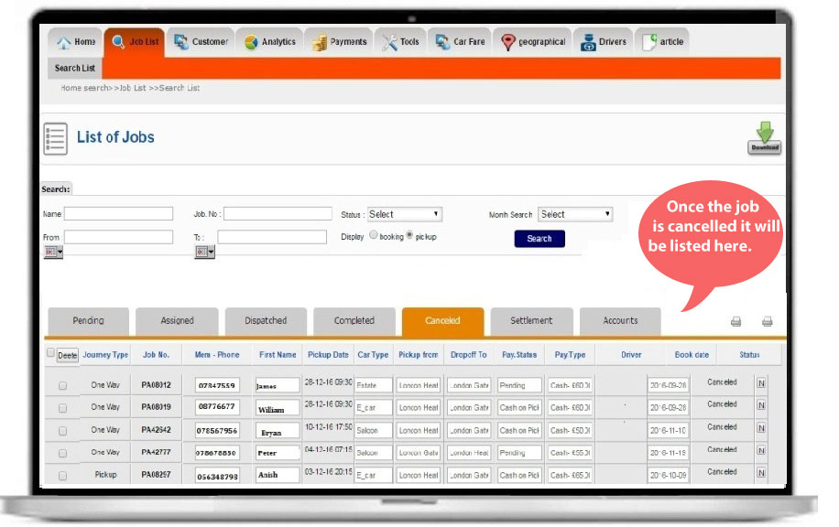
A cancelled job of the customer has shown below

Slide 13
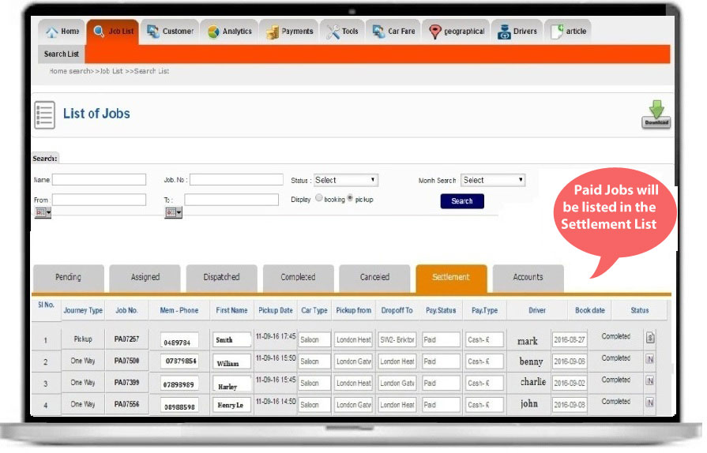
Once the Settlement has done, paid jobs will be moved to the SETTLEMENT List which has shown below.

Slide 14
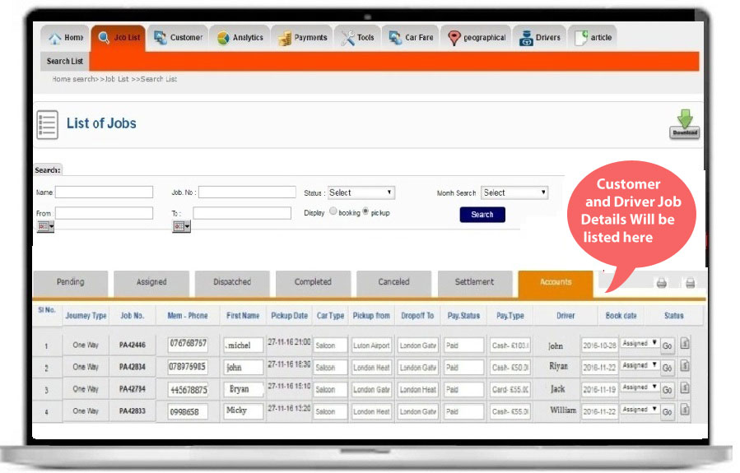
In Account List, Customer and Driver Job Details will be listed which has shown below.

Slide 15
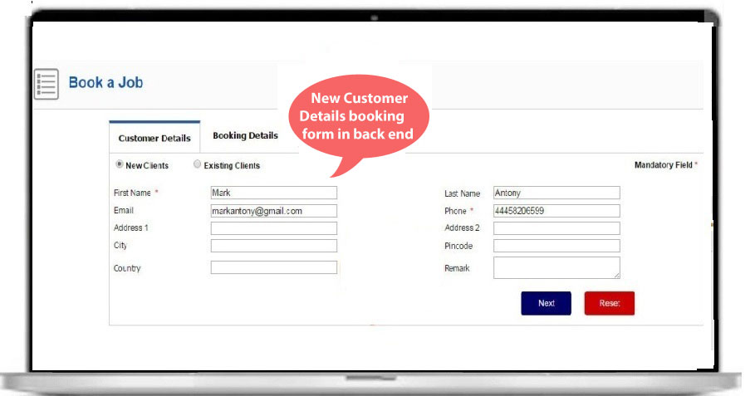
New Customer Job Booking from the back end which has shown below

Slide 16
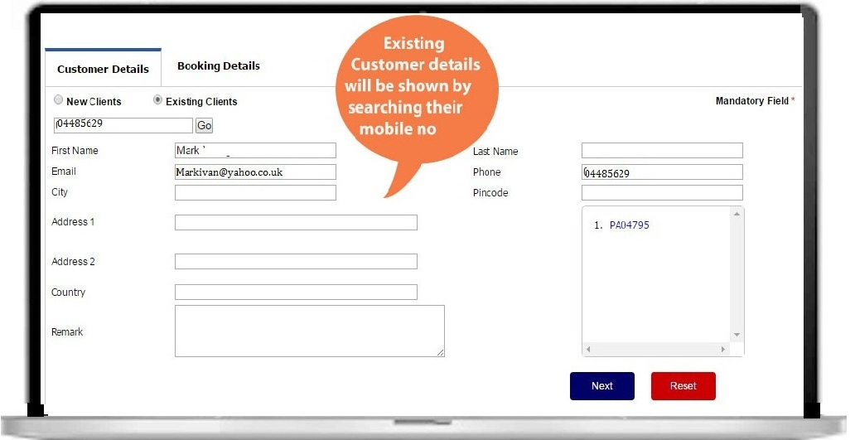
In Existing Clients Option, you can get the details of the existing customers by searching their mobile no which has shown below.

Slide 17
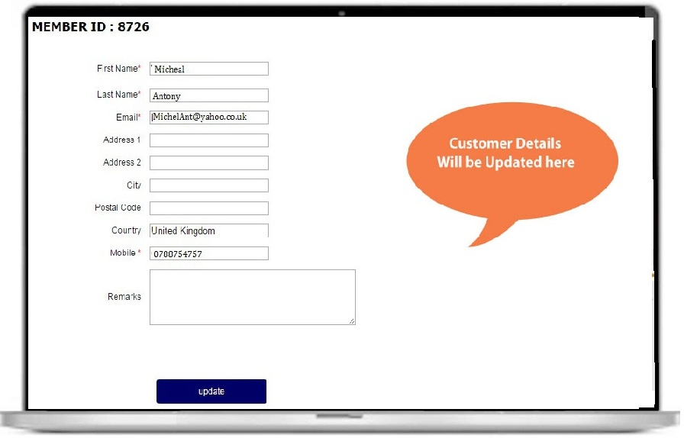
Customer Details will be updated in the Customer Profile which has shown below.

Slide 18
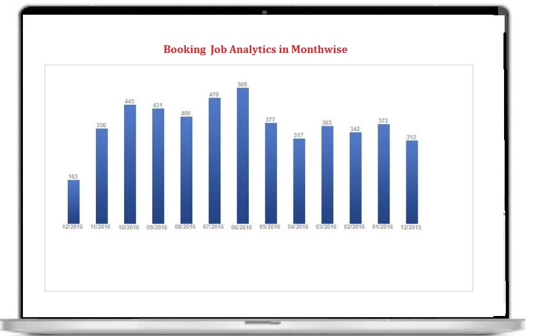
Month wise Booking and Completed Job Analytics will be generated in Analytics which has shown below.

Slide 19
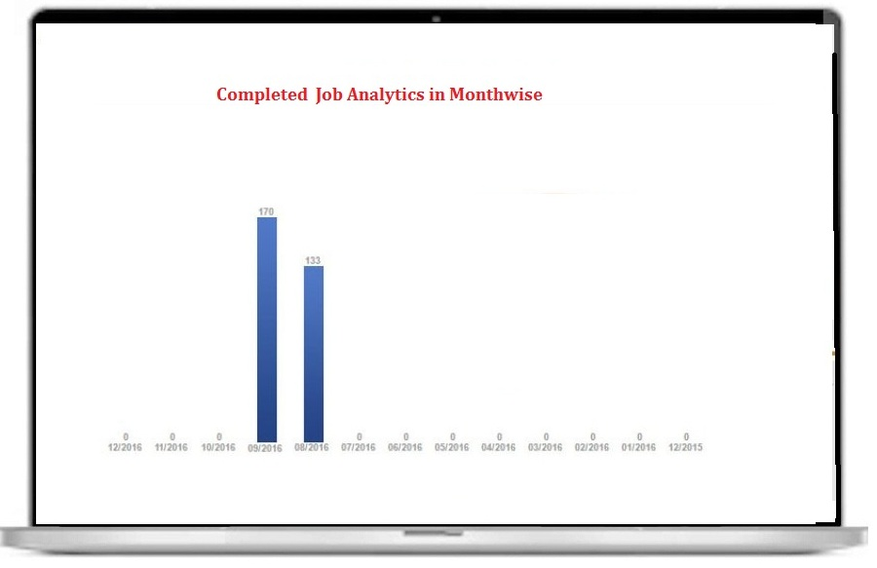
Month wise Booking and Completed Job Analytics will be generated in Analytics which has shown below.

Slide 20
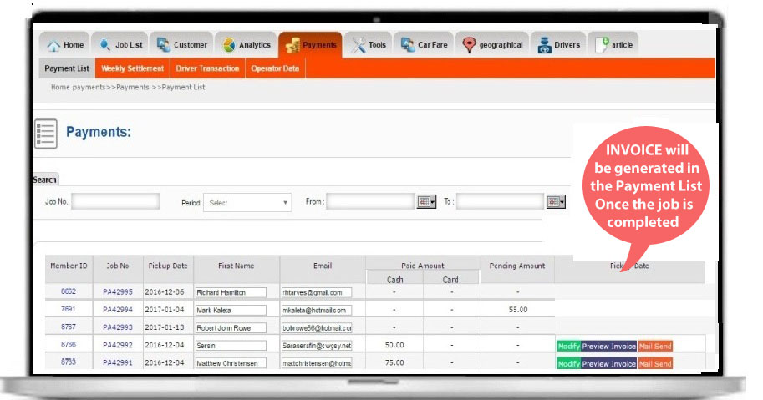
In payment List you have the option to modify, Preview and send mail to the customer. You can also search customer by their JOB NO and enable MAIL SEND option to send INVOICE to the Customer.

Slide 21
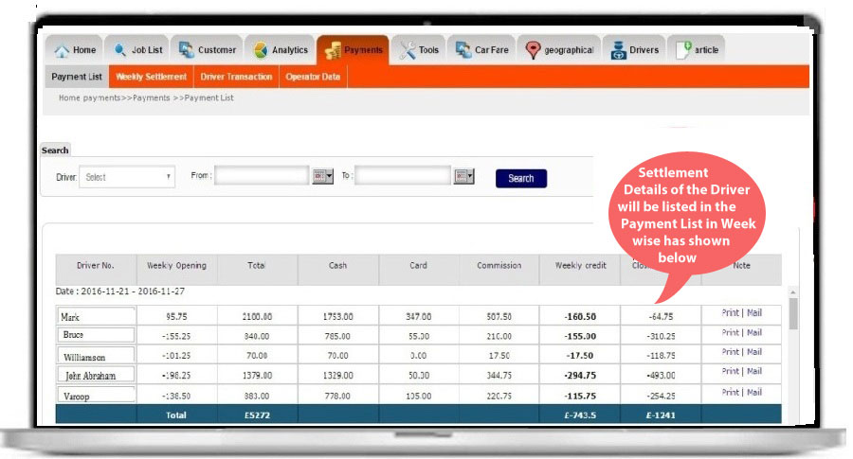
Weekly Settlement will be done and settlement details of the driver will be listed in the PAYMENT LIST which has shown below.

Slide 22
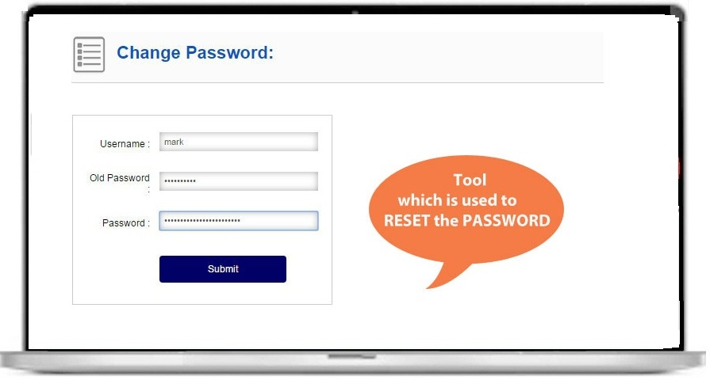
Here, we have the TOOL Option which is used to RESET the PASSWORD which has shown below.

Slide 23
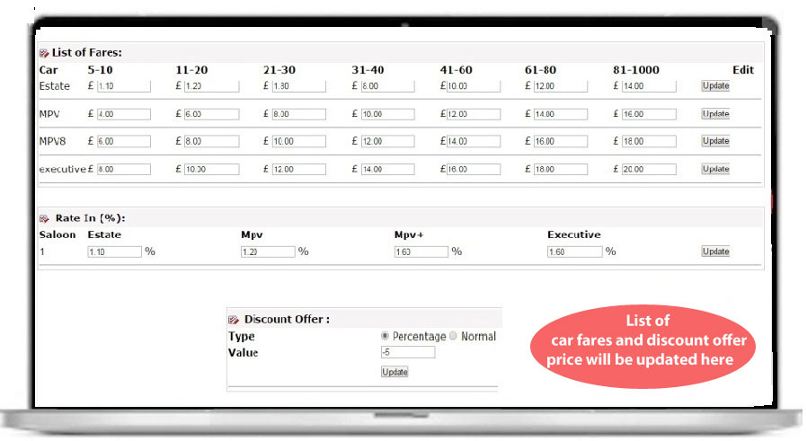
List of Car fares and Discount price will be updated in this list

Slide 24
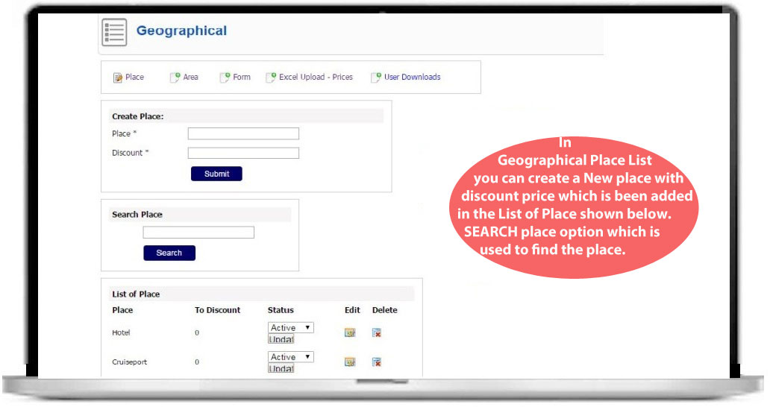
In GEOGRAPHICAL Form you have four options i.e. Place , Area , Form , Excel –Price Upload and User Downloads.

Slide 25
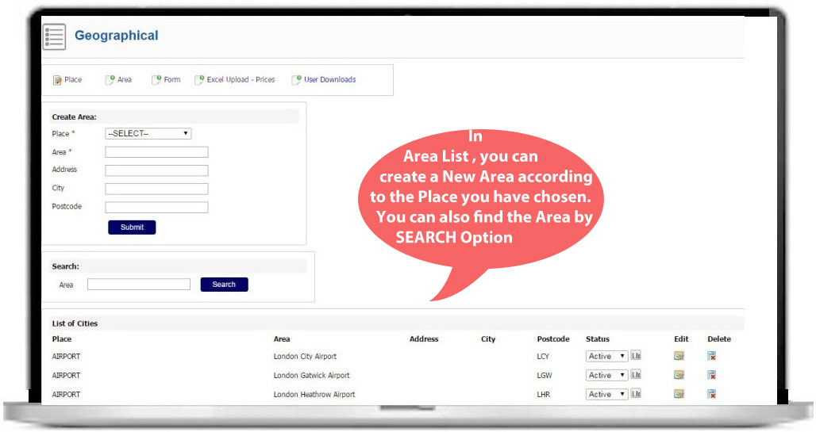
AREA LIST OPTION
Here you can add an area with respect to the PLACE which you have chosen

Slide 26
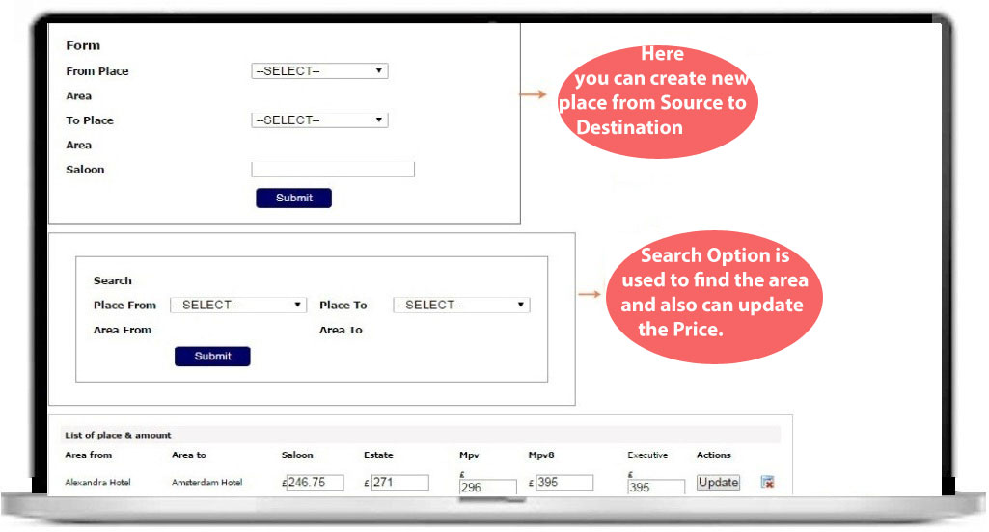
FORM OPTION
Here you have the option to create a place from SOURCE to DESTINATION and also can have SEARCH Option which is used to update the price has shown below.

Slide 27
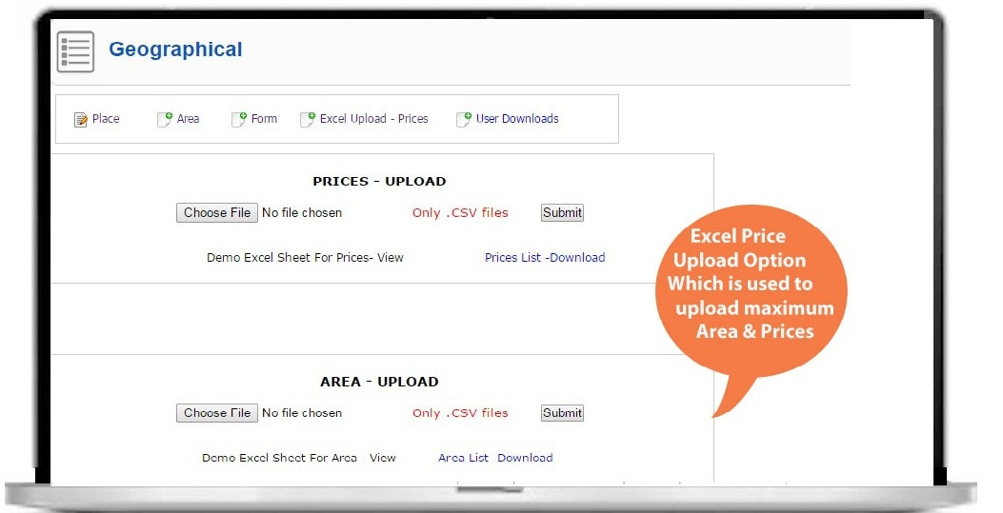
EXCEL PRICE UPLOAD OPTION
This option is used to upload the MAXIMUM Prices and Area list in the EXCEL Format.

Slide 28
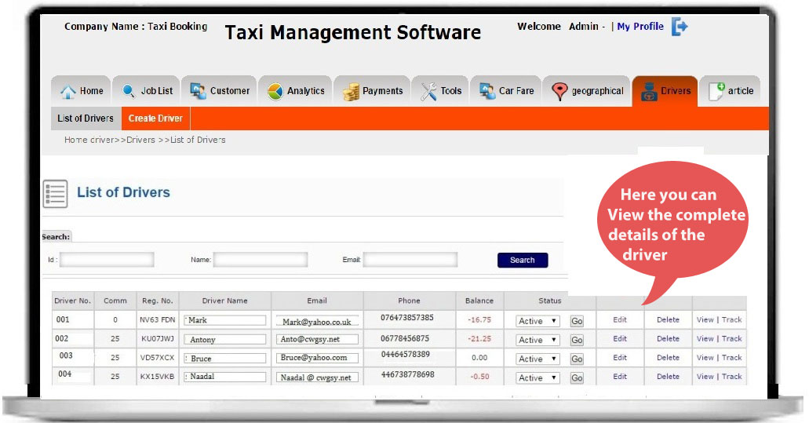
DRIVER LIST
Here List of Drivers with their complete details including their photo , license no , vehicle type , vehicle License no etc. which will be shown in the VIEW Option

Slide 29
THANK YOU

